Slide 1
ATOMIC ENERGY CENTRAL SCHOOL-3
MODULE-1
TOPIC-p-BLOCK ELEMENTS
CHAPTER: 15 GROUP ELEMENTS

Slide 2
INTRODUCTION
There are 6 elements in 15 group of periodic table i.e. Nitrogen, phosphorus, arsenic, antimony,bismuth & moscovium.
These are called as p- block elements because the last electron enter in p- subshell of the atom of the element.
Here nitrogen and phosphorus are non-metals, As and Sb are metalloids and Bismuth and moscovium (Mc) are typical metals.

Slide 3
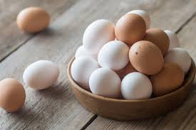
Occurrence:
Molecular nitrogen comprises 78% by volume of the atmosphere.
In the earth’s crust, it occurs as sodium nitrate, NaNO3 (called Chile
saltpetre) and potassium nitrate (Indian saltpetre). It is found in the
form of proteins in plants and animals.
Phosphorus occurs in minerals of the apatite family. It is present in bones as well as in living cells. Phosphoproteins are present in milk and eggs.
Arsenic, antimony and bismuth are found mainly as sulphide minerals. Moscovium is a synthetic radioactive element.

Slide 4
Electronic configuration
General electronic configuration of 15 group elements : ns²np_{x}¹np_{y}¹np_{z}¹
^{Here} s- subshell is completely filled and p- subshell is half filled is symmetric providing extra stability to the electronic configuration.

Slide 5
Trends in atomic & physical properties
Atomic & ionic radii : Covalent and ionic (in a particular state) radii increase in down the group. There is a considerable increase in covalent radius from N to P. However, from As to Bi only a small increase in covalent radius is observed. This is due to the presence of completely filled d and/or f orbitals in heavier elements.
Covalent radius (pm) N(70), P (110), As (121), Sb(141), Bi (148).
Ionisation Enthalpy : Ionisation enthalpy decreases down the group due to gradual increase in atomic size.
First ionization enthalpy of this group element is higher than group 14 and group 16 elements, due to stable electronic configuration.

Slide 6
Trends in physical properties
Atomicity :All the elements of this group are polyatomic. Physical state: Dinitrogen is a diatomic gas while all others are solids.
Metallic character increases down the group. Nitrogen and phosphorus are non-metals, arsenic and antimony metalloids and bismuth is a metal. This is due to decrease in ionisation enthalpy and increase in atomic size.
The boiling points, in general, increase from top to bottom in the group but the melting point increases upto arsenic and then decreases upto bismuth.
Allotropy : except nitrogen, all the elements show allotropy.

Slide 7
Trends in chemical properties
Oxidation satates and reactivity : The common oxidation states of these elements are –3, +3 and +5. The tendency to exhibit –3 oxidation state decreases down the group due to increase in size and metallic character. In fact last member of the group, bismuth hardly forms any compound in –3 oxidation state. The stability of +5 oxidation state decreases down the group. The only well characterized Bi (V) compound is BiF5. The stability of +5 oxidation state decreases and that of +3 state increases (due to inert pair effect) down the group. Besides +5 oxidation state, nitrogen exhibits + 1, + 2, + 4 oxidation states also when it reacts with oxygen. However, it does not form compounds in +5 oxidation state with halogens as nitrogen does not have d-orbitals to accommodate electrons from other elements to form bonds.

Slide 8
Trends in chemical properties
Oxidation states and reactivity :
In the case of nitrogen, all oxidation states from +1 to +4 tend to disproportionate in acid solution. For example,
3HNO₂ -----> HNO₃ + H₂O + 2NO ( here +3 -----> +5 and +2)
Similarly, in case of phosphorus nearly all intermediate oxidation states disproportionate into +5 and –3 both in alkali and acid.
4H₃PO₃ --> 3H₃PO₄ + PH₃ (here +3 -----> +5 and -3)
However +3 oxidation state in case of arsenic, antimony and bismuth becomes
increasingly stable with respect to disproportionation.

Slide 9
Trends in chemical properties
Reactions with oxygen
All these elements form two types of oxides: E₂O₃ and E₂O₅.
The oxide in the higher oxidation state of the element is more acidic than that of lower oxidation state.
Their acidic character decreases down the group.
The oxides of the type E₂O₃ of nitrogen and phosphorus are purely acidic.
Oxides of arsenic and antimony amphoteric and
Oxides of bismuth predominantly basic.

Slide 10
Trends in chemical properties
Reaction with hydrogen
All the elements of Group 15 form hydrides of the type EH₃ where E = N, P, As, Sb or Bi.
The stability of hydrides decreases from NH₃ to BiH₃ which can be observed from their bond dissociation enthalpy.
Consequently, the reducing character of the hydrides increases down the group.
Ammonia is only a mild reducing agent while BiH₃ is the strongest reducing agent amongst all the hydrides.
Basicity also decreases in the order NH₃ > PH₃ > AsH₃ > SbH₃ > BiH₃.
Due to high electronegativity and small size of nitrogen, NH₃ exhibits
hydrogen bonding in solid as well as liquid state. Because of this, it has higher melting and boiling points than that of PH₃.

Slide 11
Trends in chemical properties
Reaction with halogens : These elements react to form two series of halides, EX₃ and EX₅.
Nitrogen does not form pentahalide due to non-availability of the d orbitals in its valence shell.
Pentahalides are more covalent than trihalides. This is due to the fact that in pentahalides +5 oxidation state exists while in the case of trihalides +3 oxidation state exists. Since elements in +5 oxidation state will have more polarising power than in +3 oxidation state, the covalent character of bonds is more in pentahalides.
All the trihalides of these elements except those of nitrogen are stable. In case of nitrogen, only NF₃ is known to be stable. Trihalides except BiF₃ are predominantly covalent in nature.

Slide 12
Trends in chemical properties
Reaction with metals :
All these elements react with metals to form their binary compounds exhibiting –3 oxidation state, such as, Ca₃N₂ (calcium nitride) Ca₃P₂ (calcium phosphide), Na₃As (sodium arsenide), Zn₃Sb₂ (zinc antimonide) and Mg₃Bi₂ (magnesium bismuthide).

Slide 13
Nitrogen
Preparation:
Dinitrogen is produced commercially by the liquefaction and fractional distillation of air.
In the laboratory, dinitrogen is prepared by treating an aqueous solution of ammonium chloride with sodium nitrite.
NH₄CI(aq) + NaNO₂(aq) ------> N₂(g) + 2H₂O(l) + NaCl (aq)
Very pure nitrogen can be obtained by the thermal decomposition of sodium or barium azide. Ba(N₃)₂-----> Ba + 3N₂

Slide 14
Properties of dinitrogen
Dinitrogen is a colourless, odourless, tasteless and non-toxic gas.
Nitrogen atom has two stable isotopes: ¹⁴N and ¹⁵N.
It has a very low solubility in water (23.2 cm3 per litre of water at 273 K and 1 bar pressure) and low freezing and boiling points.
Dinitrogen is rather inert at room temperature because of the high bond enthalpy of N, N three bonds.

Slide 15
Uses of dinitrogen
The main use of dinitrogen is in the manufacture of ammonia and other industrial chemicals containing nitrogen, (e.g., calcium cyanamide).
It also finds use where an inert atmosphere is required (e.g., in iron and steel industry,inert diluent for reactive chemicals).
Liquid dinitrogen is used as a refrigerant to preserve biological materials, food items and in cryosurgery.

Slide 16
Compounds of Nitrogen
Ammonia (NH₃)
_{Preparation of ammonia}
_{Haber’s Process :} On a large scale, ammonia is manufactured by Haber’s process.
N₂(g) + 3H₂(g) ----->2NH3(g); ΔH⁰ = – 46.1 kJ mol^{–1}
In accordance with Le Chatelier’s principle, high pressure & low temperature would favour the formation of ammonia.

Slide 17
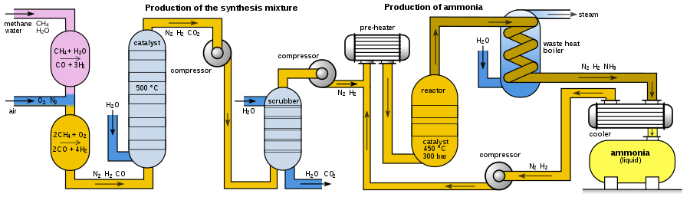
Preparation of ammonia
Haber’s Process

Slide 18
Properties of ammonia (NH₃)
Ammonia is a colourless gas with a pungent odour.
Its freezing and boiling points are 198.4 and 239.7 K respectively.
In the solid and liquid states, it is associated through hydrogen bonds as in the case of water and that accounts for its higher melting and boiling points than expected on the basis of its molecular mass.
The ammonia molecule is trigonal pyramidal with the nitrogen atom at the apex. It has three bond pairs and one lone pair of electrons.
Ammonia gas is highly soluble in water. Its aqueous solution is
weakly basic due to the formation of OH– ions.
NH₃(g) + H₂O(l) ---> NH₄⁺(aq) + OH–(aq)

Slide 19
Nitric acid
(Preparation)
Ostwald’s process : On a large scale nitric acid is prepared mainly by this method which is based upon catalytic(i.e. Pt/Rh) oxidation of NH₃ by atmosphericoxygen.
4NH₃ (g) + 5O₂ (g) --- ----> 4NO (g) + 6H O (g)
Nitric oxide thus formed combines with oxygen giving NO₂. Nitrogen dioxide so formed, reacts with water to form nitric acid.
3NO₂ + H₂O(l) -----> 2HNO₃(aq) + NO(g)
NO thus formed is recycled and the aqueous HNO₃ can be concentrated by distillation upto ~ 68% by mass. Further concentration to 98% can be achieved by dehydration with concentrated H2SO4.

Slide 20
Nitric acid
(Properties)
It is a colourless liquid .
In aqueous solution, nitric acid behaves as a strong acid.
Concentrated nitric acid is a strong oxidising agent and attacks most metals except noble metals such as gold and platinum.
Products of oxidation depend upon the concentration of the acid, temperature and the nature of the material undergoing oxidation.
3Cu + 8 HNO₃(dilute) ----> 3Cu(NO₃)₂ + 2NO + 4H₂O
Cu + 4HNO₃(conc.) -------> Cu(NO₃)₂ + 2NO₂ + 2H₂O
4Zn + 10HNO3(dilute) --->4 Zn (NO₃)₂ + 5H₂O + N₂O

Slide 21
Nitric acid
(Properties)
Some metals (e.g., Cr, Al) do not react with concentrated nitric acid because of the formation of a passive film of oxide on the surface.
Concentrated nitric acid also oxidises non–metals and their compounds. Iodine is oxidised to iodic acid, carbon to carbon dioxide, sulphur to H₂SO₄, and phosphorus to H₃PO₄.
I₂ + 10HNO₃ --> 2HIO₃ + 10NO₂ + 4H₂O
C + 4HNO₃ ---> CO₂ + 2H₂O + 4NO₂
P₄ + 20HNO₃ --> 4H₃PO₄ + 20NO₂ + 4H₂O

Slide 22
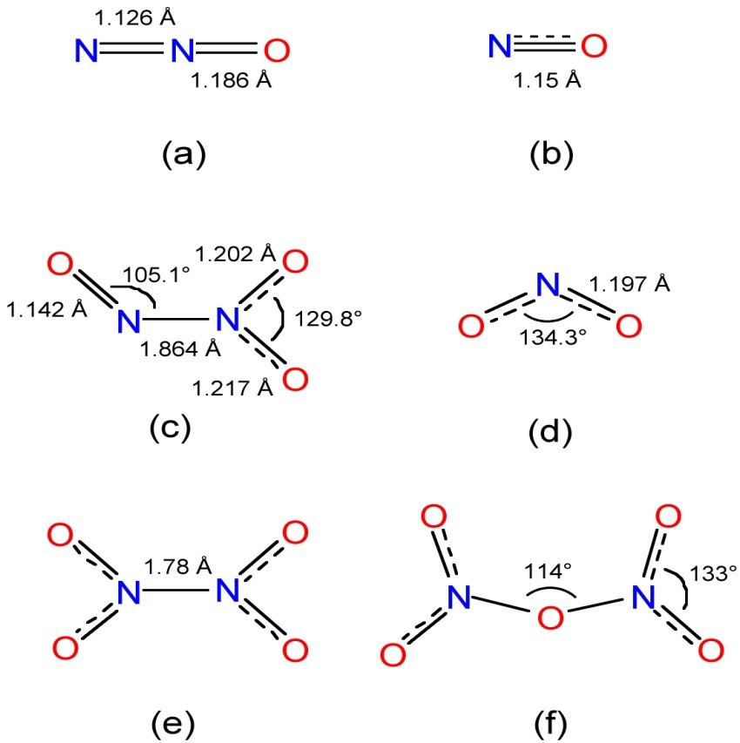
Oxides of nitrogen
(Structures only)
The binary compounds of nitrogen with oxygen are called as oxides of nitrogen.
Nitrogen forms a number of oxides in different oxidation states(i.e. N₂O, NO,NO₂, N₂O₃, N₂O₅ etc.)
Where N₂O is linear, NO₂ is angular and N₂O₃ and N₂O₅ are planar .

Slide 23
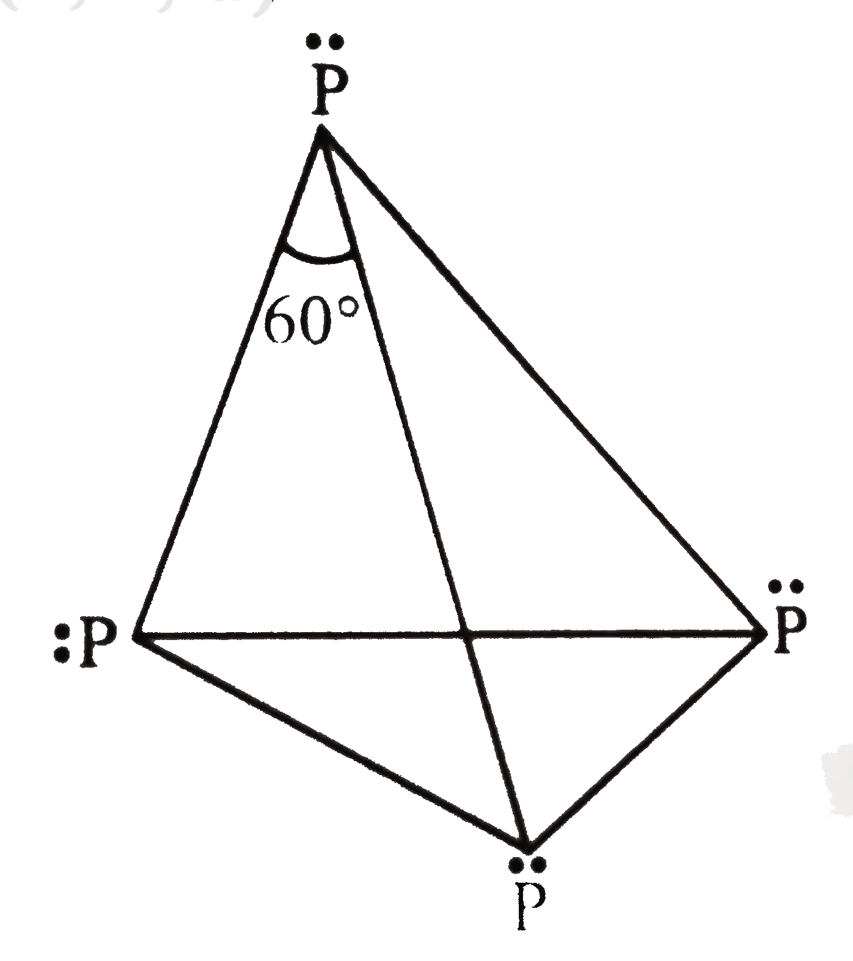
Phosphorus
(allotropic forms)
White Phosphorus
Phosphorus is found in many allotropic forms, the important ones being white, red and black.
White phosphorus is a translucent white waxy solid. It is poisonous, insoluble in water but soluble in carbon disulphide and glows in dark (chemiluminescence).
It is less stable, more reactive than the other forms because of angular strain in P₄ molecule.
It consists of discrete tetrahedral P₄ molecule.

Slide 24
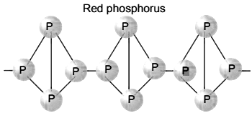
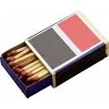
Red phosphorus
Red phosphorus is obtained by heating white phosphorus at 573K in an inert atmosphere for several days.
Red phosphorus possesses iron grey lustre. It is odourless, nonpoisonous
and insoluble in water as well as in carbon disulphide.
Chemically, red phosphorus is much less reactive than whitephosphorus.
It does not glow in the dark.
It is polymeric, consisting of chains of P₄ tetrahedron.

Slide 25
Compounds of phosphorous
(Phosphine)
Introduction: It is basic hydride of phosphorus with molecular formula PH₃, whichh is poisonous gas.
Preparation : In the laboratory, it is prepared by heating white phosphorus with concentrated NaOH solution in an inert atmosphere of CO₂.
P₄ + 3NaOH + 3H₂O ---------> PH₃ + 3 NaH₂PO₂
Properties : It is a colourless gas with rotten fish smell and is highly poisonous. It explodes in contact with traces of oxidising agents like HNO₃, Cl₂ andBr₂ vapours.
it is absorbed in HI to form phosphonium iodide (PH₄I)
it absorbed in copper sulphate or mercuric chloride solution, the corresponding
phosphides are obtained.
3CuSO₄ + 2PH₃ ----> Cu₃P₂ + 3H₂SO₄
3HgCl₂ + 2PH₃ --> Hg₃P₂ + 6HCl

Slide 26
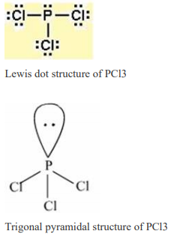
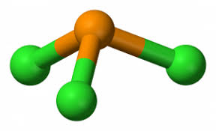
Compounds of phosphorous
(Phosphorus trichloride)
Preparation : It is obtained by passing dry chlorine over heated white phosphorus or by the action of thionyl chloride with white phosphorus.
P₄ + 6Cl₂ -------> 4PCl₃
P₄ + 8SOCl₂ ----> 4PCl₃ + 4SO₂ + 2S₂Cl₂
Properties :It is a colourless oily liquid and hydrolyses in the presence of moisture.
PCl₃ + 2H₂O--->H₃PO₃ + 3HCl
It reacts with organic compounds containing –OH group such as CH₃COOH, C₂H₅OH.
3CH₃COOH + PCl₃-----> 3CH₃COCl + H₃ PO₃
3C₂H₅OH + PCl₃ --> 3C₂H₅Cl + H₃PO₃
Structure : Central atom P is sp³ hybridised,one lp on P atom, so that this molecule is pyramidal in shape.

Slide 27
Compounds of Phosphorus
(Phosphorus pentachloride)
Preparation : Phosphorus pentachloride is prepared by the reaction of white
phosphorus with excess of dry chlorine or by the action of thionilcholoride (SO₂Cl₂) on white phosphorus.
P₄ +10Cl₂ -----> 4PCl₅
P₄ + 10 SOCl₂ ----> 4PCl₅ + 10 SO₂
Properties : Properties
PCl₅ is a yellowish white powder and in moist air, it hydrolyses to POCl₃ and finally gets converted to phosphoric acid(H₃PO₃).
PCl₅ + H₂O -----> POCl₃ + 2HCl
POCl₃ + 3H₂O --->H₃PO₄ + 3HCl
When heated, it sublimes but decomposes on stronger heating.
PCl₅ ------> PCl₃ + Cl₂
It reacts with organic compounds containing –OH group converting them to chloro derivatives.
CH₃COOH + PCl₅ ---->CH₃COCl + POCl₃ +HCl

Slide 28
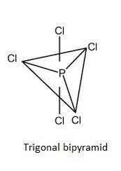
Structure of PCl₅
There are five P-Cl bonds in this structure, these are not equal.
Three P-Cl bonds are equatorial bonds are equal but shorter than axial P-Cl bonds.
Regular structure no lp on the P atom
The shape & geometry of this molecule is trigonal bipyramidal. With bond length 202 pm (equatorial) and 240 pm (axial)

Slide 29
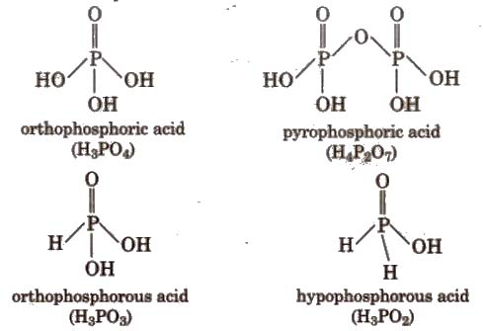
Oxoacids of Phosphorus
Phosphorus forms a number of oxoacids.
In oxoacids phosphorus is tetrahedrally surrounded by other atoms.
All these acids contain at least one P=O bond and one P–OH bond.
The H atoms connected to O-atom are metal replaceable decide the basicity of acid.
The H atom connected directly with P atom decide its reducing nature.

Slide 30
Thanks

